Slide 1
CSE 551 Foundations of Algorithms
Instructor: Arun Sen
Office: BYENG 530
Tel: 480-965-6153
E-mail: asen@asu.edu
Office Hours: TTh 3:30-5:00
TA: Kaustav Basu
Office: TBA
E-mail: Kaustav.Basu@asu.edu
TA: Sandipan Choudhuri
Office: TBA
E-mail: schoud13@asu.edu

Slide 2
Textbook and Course Outline Recommended Text: Algorithm Design by Kleinberg & Tardos Note: A significant amount of course material will come from sources other than the textbook. As such, class attendance is essential.
Introduction
Growth of functions
Complexity of computation
Recurrence relations
Divide and Conquer
MaxMin in a sequence
Binary search
Quicksort
Mergesort
Strassen’s matrix multiplication
Dynamic Programming
Matrix chain multiplication
Optimal polygon triangulation
Optimal binary tree
Longest common subsequence
Traveling Salesman Problem
Greedy Algorithms
Chromatic number
Knapsack
Set cover
Minimum spanning tree
Event scheduling
Network Flows
Max-flow Min-cut Theorem
Ford-Fulkerson Algorithm
NP-Completeness
Problem transformation
No-wait flow shop scheduling
3-Satisfiability
Traveling Salesman Problem
Node Cover
Approximation Algorithms
Node Cover
Bin Packing
Scheduling
Steiner Trees
*** The course outline may be modified (some problems may be replaced by other problems in each of the topics), depending on class needs and progress.

Slide 3
Grading Policy for CSE 551
There will be two mid-terms and a final. In addition, there will be programming and homework assignments as well.
90% will ensure A, 80% will ensure B, 70% will ensure C and so on
Loss of points due to late submission of assignments
1 day 50%
2 days 75%
3 days 100%
Tests and Assignments | Percentage
Final | 35%
Midterms 1 and 2 | 20% + 20%
HW & Programming Assg. | 25%

Slide 4
Cheating Policy
Any case of cheating will be severely dealt with.
Penalty for cheating will be in accordance with the policies of the Fulton Schools of Engineering and Arizona State University.
Multiple offenders may be removed from the program and the University.

Slide 5

Foundations of Algorithms
Let´s start at the very beginning A very good place to start When you read you begin with A-B-C When you code you begin with A-L-G

Slide 6
What is an Algorithm?
An algorithm may be broadly defined as a step by step procedure for solving a problem or accomplishing some end. It is a finite sequence of unambiguous, executable steps that ultimately terminate if followed.
Procedure 1
Make a list of all positive integers
Arrange this list in descending order (from largest to smallest)
Extract the first integer from the resulting list
Stop.
Procedure 1 is NOT an algorithm.

Slide 7
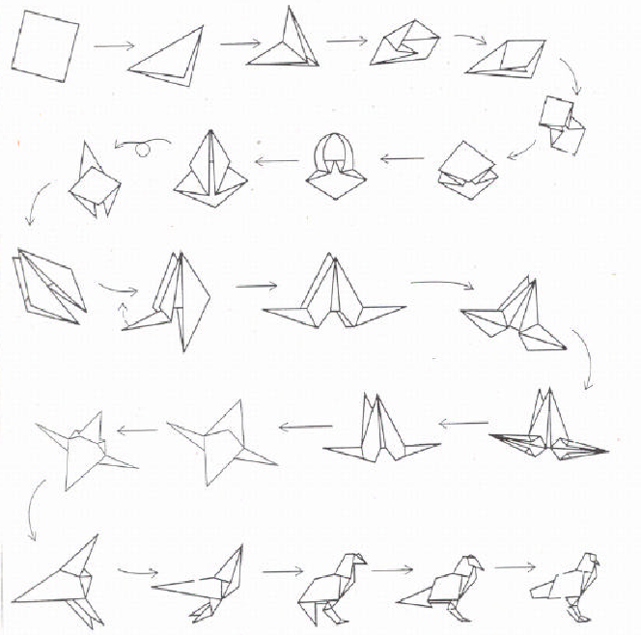
Example in Origami: Algorithm for making a bird

Slide 8

Multiple target tracking using a network of UAVs
Algorithms = Problem Solving

Slide 9
Multiple Target Tracking Using a Network of UAVs

Slide 10
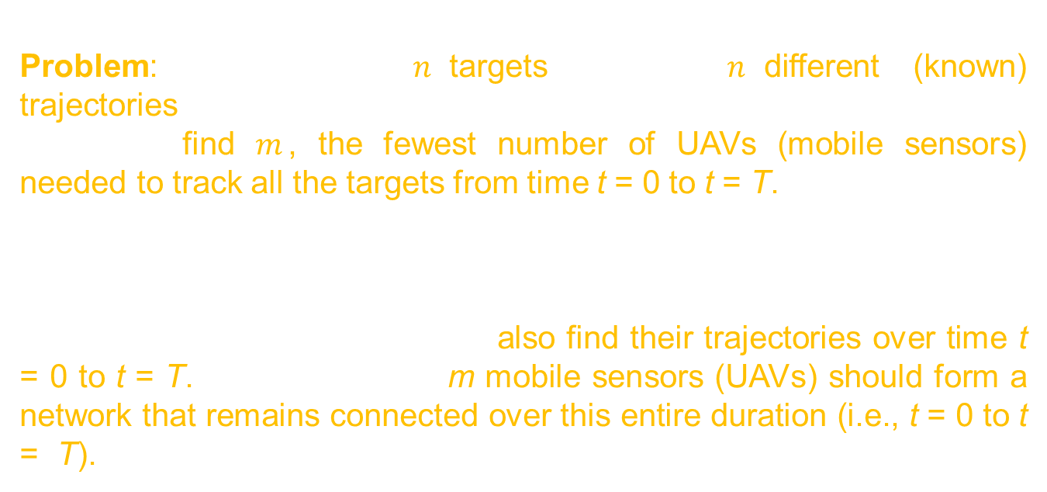
Multiple target tracking using a network of UAVs
Problem: Given a set of $n$ targets moving in $n$ different (known) trajectories in a two (or three) dimensional space, with specified velocities, find $m$, the fewest number of UAVs (mobile sensors) needed to track all the targets from time t = 0 to t = T.
A tracker/sensor can only sense a target if the target is within the sensing range of the sensor. In addition to finding the fewest number of sensors, the algorithm should also find their trajectories over time t = 0 to t = T. Moreover, these m mobile sensors (UAVs) should form a network that remains connected over this entire duration (i.e., t = 0 to t = T).

Slide 11

Multiple target tracking using a network of UAVs

Slide 12
Target Visualization
Target + Tracker Visualization

Slide 13

Multiple target tracking using a network of UAVs
Abstract version of the multiple target tracking using a network of UAVs problem:
Given a set of moving red points $p_{1}, …, p_{n}$ on a two dimensional plane and their movement described by parametric equations: i.e., the $x$ and $y$ coordinates of point $p_{i}, 1≤i≤n$, at time $t$ is given by $x_{i}\left(t\right),y_{i}\left(t\right), 0≤t≤T$.
Find the fewest number of moving blue points $q_{1}, …, q_{m}$, such that the distance between every red point $p_{i}$ to a blue point $q_{j}$ is at most $δ$, a pre-specified threshold value, at all times.
In other words, find smallest $m$, such that $∀p_{i}, 1≤i≤n, ∃$a $q_{j},1≤j≤m$ such that the distance between the points $p_{i}$ and $q_{j}$, $d(p_{i}$, $q_{j})≤δ$, for all$t, 0≤t≤T$. In addition to finding the smallest $m$, the solution should also find the parametric equations for each $q_{j},1≤j≤m$, that provide the $x$ and $y$ coordinates of points $q_{j}$ for all $t$, $0≤t≤T$.

Slide 14
Visualization of Target Tracking Problem

Slide 15
Algorithms = Problem Solving
Example in Manufacturing:
Various wafers (tasks) are to be processed in a series of stations. The processing time of the wafers in different stations is different. Once a wafer is processed on a station it needs to be processed on the next station immediately, i.e., there cannot be any wait.
In what order should the wafers be supplied to the assembly line so that the completion time of processing of all wafers is minimized?

Slide 16
S1
S2
S8
w1
t₁₁
t₁₂
t₁₈
w2
t₂₁
t₂₂
t₂₈
w3
t₃₁
t₃₂
t₃₈

Slide 17
w1 : t₁₁ = 4, t₁₂= 5;
w2 : t₂₁ = 2, t₂₂ = 4;
w1 :
w2 :
w2:
w2 :
w1:
Completion Time in the first ordering = 13
Completion Time in the second ordering = 11
S1 : 4 | S2 : 5
S1: 2 |  | S2 : 4
S1:2 | S2 : 4
S1: 2 | S2 : 4
S1 : 4 | S2 : 5

Slide 18
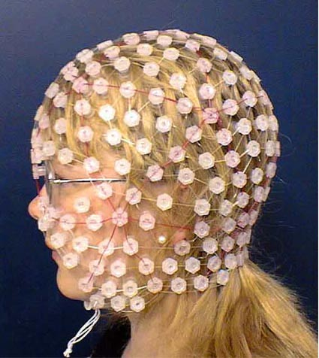
Sensor Placement Problem
Sensor Placement in a Temperature Sensitive Environment

Slide 19
Sensor Placement Problem
Sensor Placement in a Temperature Sensitive Environment

Slide 20
Sensor Placement Problem
Bio-sensors implanted in human body dissipate energy during their operation and consequently raise the temperature of the surrounding.
A temperature sensitive environment like the human body or brain can tolerate increase in temperature only up to a certain threshold.
One needs to make sure that the rise in temperature due to the operation of implanted bio-sensors in temperature sensitive environments such as human/animal body does not exceed the threshold and cause any adverse impact.

Slide 21
Thermal Model and Analysis
A sensor is expected to operate for a certain duration of time.
The rise is temperature in the area surrounding the sensor will be dependent on the duration of operation.
The sensor surroundings will attain a maximum temperature during the time of operation (steady state temperature).
If the steady state temperature of a sensor exceeds the maximum allowable threshold in the surrounding, such a sensor cannot be deployed.
Question: Is it possible that a sensor whose steady state temperature does not exceed the threshold when operating in isolation, may exceed the threshold when operating with multiple other sensors?

Slide 22
Thermal Model and Analysis
We perform a thorough analysis of the heat distribution phenomenon in a temperature sensitive environment and come to the following conclusion:
There exists a critical inter-sensor distance d_{cr}, such that if the distance between any two deployed sensors is less than d_{cr}, then the temperature in the vicinity of the sensors will exceed the maximum allowable threshold.
Therefore, attention must be paid during sensor deployment to ensure that the distance between any two sensors is at least as large as d_{cr}.

Slide 23
Sensor Coverage Problem
Given:
A set of locations (or points p_{i}) to be sensed
A set of potential locations (or points q_{i}) for the placement of the sensors
A minimum separation distance (d_{cr}) between each pair of sensors.
Objective:
To deploy as few sensors as possible in the potential placement locations such that all points p_{i} are sensed and the distance between any two sensors is at least as large as d_{cr}.
Assumption
Each sensor is capable of sensing a circular area of radius r_{sen} with the location of the sensor being the center of the circle.

Slide 24
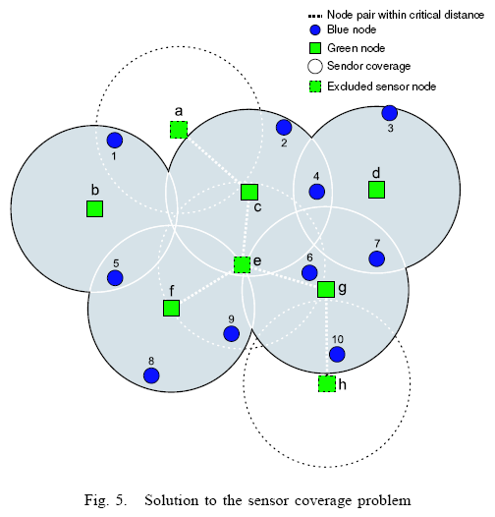
Sensor Coverage Problem

Slide 25
Sensor Coverage Problem
Formal problem definition:

Slide 26
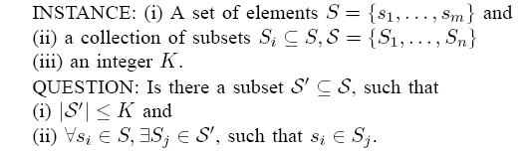
Set Cover Problem

Slide 27
Sensor Coverage as Generalized Set Cover Problem

Slide 28
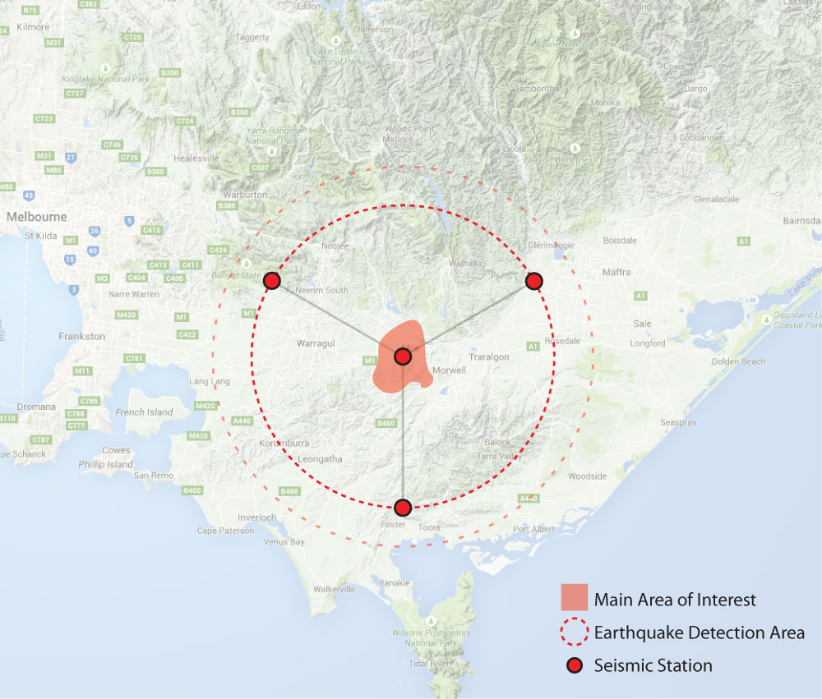
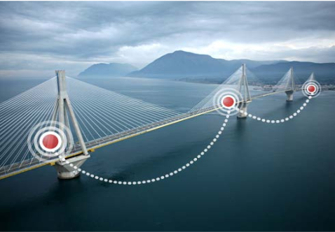
Sensor Placement in Real World Applications

Slide 29
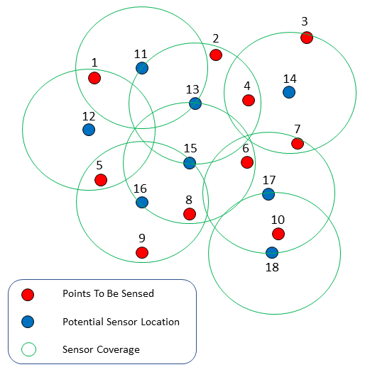
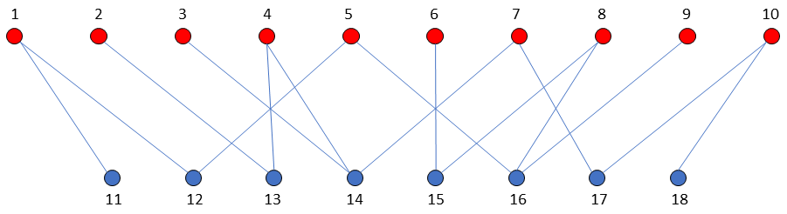

Slide 30
